Slide 1
Rockwell Elementary Principal and PTA

Slide 2
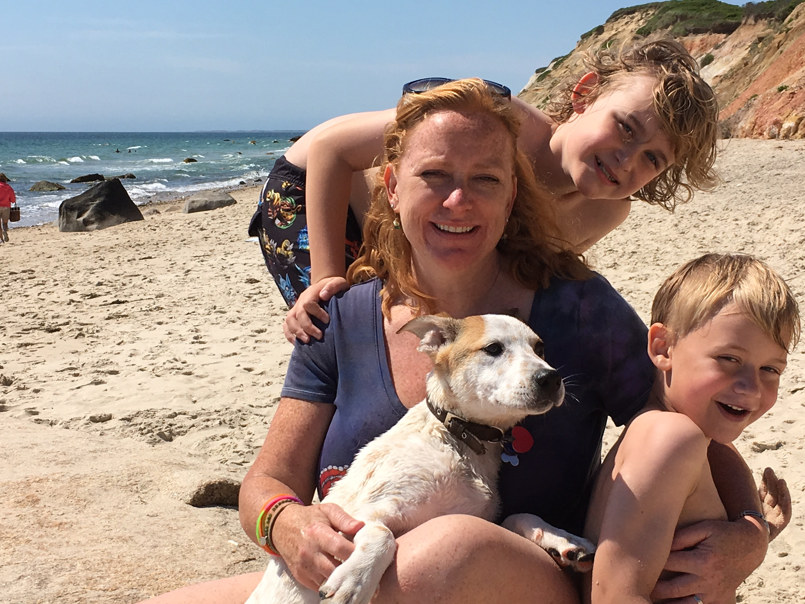
Kirsten Gometz, Principal Ryan Scott, Associate Principal

Slide 3
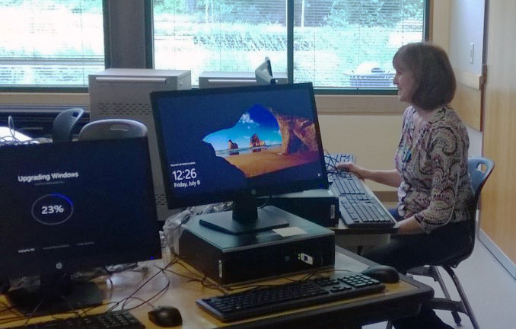
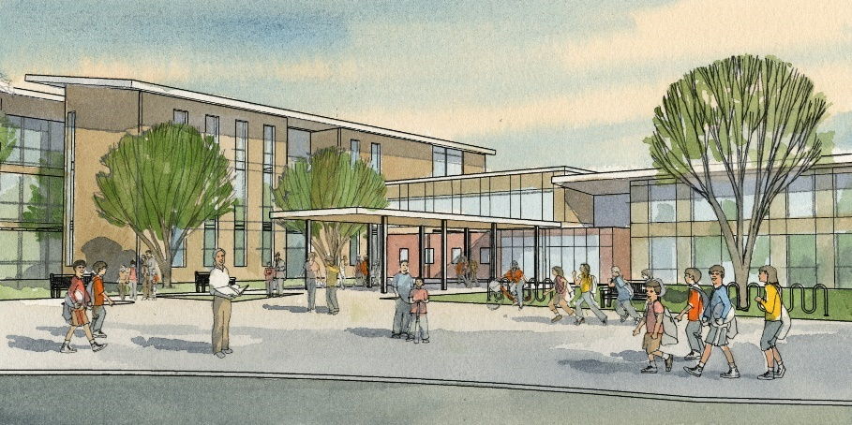
Thank you, community!
Local Educational Programs & Operations levy funding adds to the general fund
Capital levy technology funding for computers, software, copiers, network, projectors and more
Building improvement funding to repair major systems like roofs or HVAC, install energy efficient systems, safety improvements, update fields/gyms
2016 bond measure has funded two new elementary schools and one new middle school; rebuild and enlarge Kirk and Mead Elementary Schools and Juanita High School

Slide 4
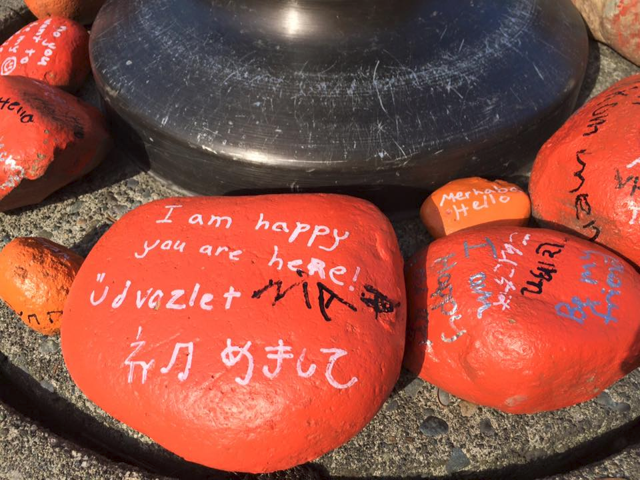
631 Students, K-5
37 Languages
26 Countries of Origin
Opened in 1982
8:30-3:00 M, T, Th, F
8:30-1:30 W
Wed 09/07 is 8:30-3:00!
AM, Lunch, PM Recess

Slide 5
Rockwell Handbook – Review and Sign

Slide 6
School + Everyday = It Adds Up
Attendance matters to academic performance.
Studies show many children who miss too many days in kindergarten and first grade can struggle academically in later years. They often have trouble mastering reading by the end of third grade.
Students are considered chronically absent if they miss 10% of school days….That’s two days a month.
Communicate with the school if your child is absent.
Keep your child home if truly sick.
Avoid extended vacations that require your children to miss school. Try to line up vacations and doctor’s appointments with the school’s schedule.
Set a regular bedtime and morning routine allowing for 9 to 11 hours of sleep.
Layout clothes and pack backpacks the night before to make your morning routines run more smoothly.
Notes:
Elementary
Your children can suffer academically if they miss 10 percent of the school year or about 18 days. That can be just one day every two weeks, and that can happen before you know it.
Some absences are unavoidable. We understand that children will get sick and need to stay home occasionally. The important thing is to get your children to school as often as possible, on time and to communicate with the school when your child will be absent.
Attendance matters as early as kindergarten. Studies show many children who miss too many days in kindergarten and first grade can struggle academically in later years. They often have trouble mastering reading by the end of third grade.
Too many absent students can affect the whole classroom, creating disruptions and slowing down instruction.
Families should avoid extended vacations that require your children to miss school. Try to line up vacations with the school’s schedule. The same goes for doctor’s appointments.
Help your student set a regular bedtime and morning routine. Make sure they get 9 to 11 hours of sleep. You can layout clothes and pack backpacks the night before to make your morning routines run more smoothly.
You can set an example for your child. Show him or her that attendance matters to you and that you won’t allow an absence unless someone is truly sick.

Slide 7
SAFE ARRIVAL PROGRAM 425-936-2671
As per WA state law, parents MUST notify school if student will be late or absent for any reason.
Safe Arrival phone is available 24 hours a day.
Please call BEFORE 9:00 am.

Slide 8
Medication at School
ALL medications must have MD order on file.
Over-the-counter items, such as cough drops, Tylenol, vitamins must have MD order on file.
Parent may choose to come to school and administer or have office staff do so.

Slide 9
Safety Policies
Students should be at school by 8:25, when teachers bring them inside. Once the 8:30 bell rings they are TARDY and must get a pass from the office.
Only the front door is kept unlocked through the day.
ALWAYS sign in at the office and get a name tag.
ALWAYS sign out WHEN YOU LEAVE (please do not “pre-sign” out).
If there is a lock down or similar emergency at school, please do not call. We will inform you of any news you need in a timely manner.
Important updates will be posted at www.lwsd.org

Slide 10
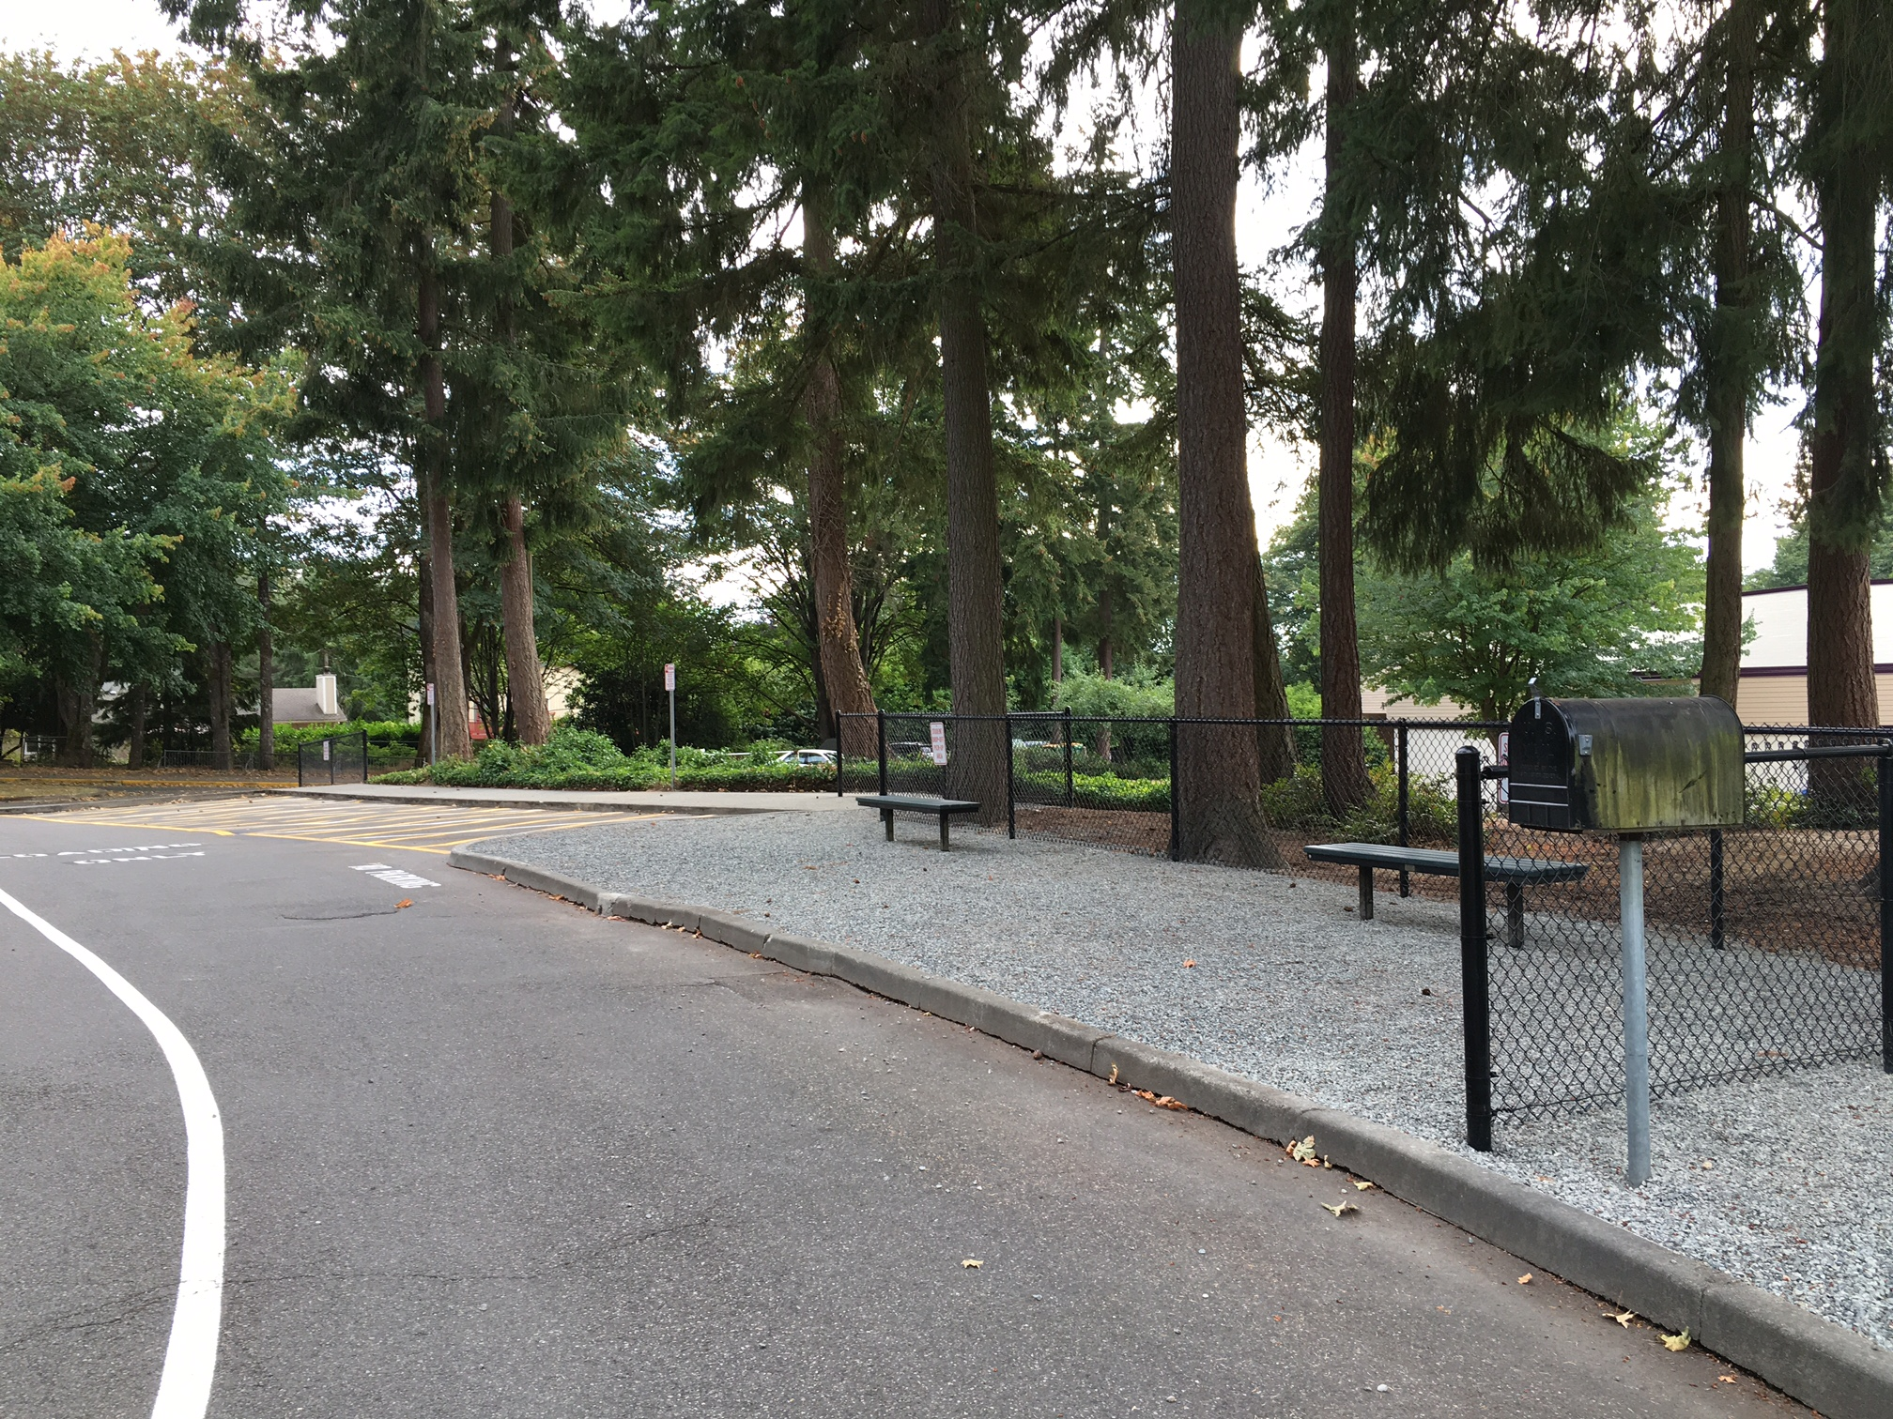
Pick up and Drop off/Visitor Parking
car car car
car car car

Slide 11
SAFETY IS OUR FIRST PRIORITY
Students ALWAYS enter and exit from the right side of the car
Staff will supervise and help students enter and exit car if needed
Do not block bus lane at any time
If line backs up to the bus lane, please wait at the curb until the next spot opens up
If you are heading north to our lot, please do NOT block traffic or cut off those who are waiting at the curb. Instead, please turn at the roundabout and return heading south, waiting at the curb if necessary.

Slide 12
Parking Lot
Do not EVER leave your car or open doors on the left side in the pick-up drop off lane
ALWAYS use crosswalks
Stay with your child in the parking lot
Travel at 7 mph or lower!
Bring your patience and understanding.
If your child rides the bus, please have them do so, from Day 1.
If they walk, please encourage them to do so. Consider walking groups from your neighborhood.

Slide 13
Contact the Teacher
Email is best for a short note or to request more information
Teachers CANNOT check email regularly through the day. Any urgent message should be a call to the office.
Teachers CANNOT accept phone calls during school hours.

Slide 14
Homework
Harris Cooper
NEA and NPTA agree, for K-2 students, 10-20 minutes a day (READ)
Grades 3-6, 30-60 minutes per day.
A little amount of homework helps students begin to develop study habits.
There are some connections between students who do homework and achievement, however the results of 35 studies see virtually no relationship between homework and achievement for elementary school students.

Slide 15
2016-2017 Rockwell Homework Policies
Kindergarten Read every night
First grade Read and Words Their Way.
Second grade Read and Wednesday Math Sheet
Third grade Read and Independent Skills Practice
Fourth grade Read and daily math page or other skill practice.
Fifth grade Read and math page (practice or enrichment)
Occasional Special Projects

Slide 16
What to do With the Time?
Service Projects (Finding a purpose)
Unstructured play with friends and siblings (Social/Emotional Skills)
Outside time (Physical health, grounding in nature)
Limit screen time (Increase attention span)
Play an instrument, play a sport, PLAY (Fine and gross motor skills, memory, patience)
Be bored (This is healthy and spurs creativity!)
GET ENOUGH SLEEP!

Slide 17
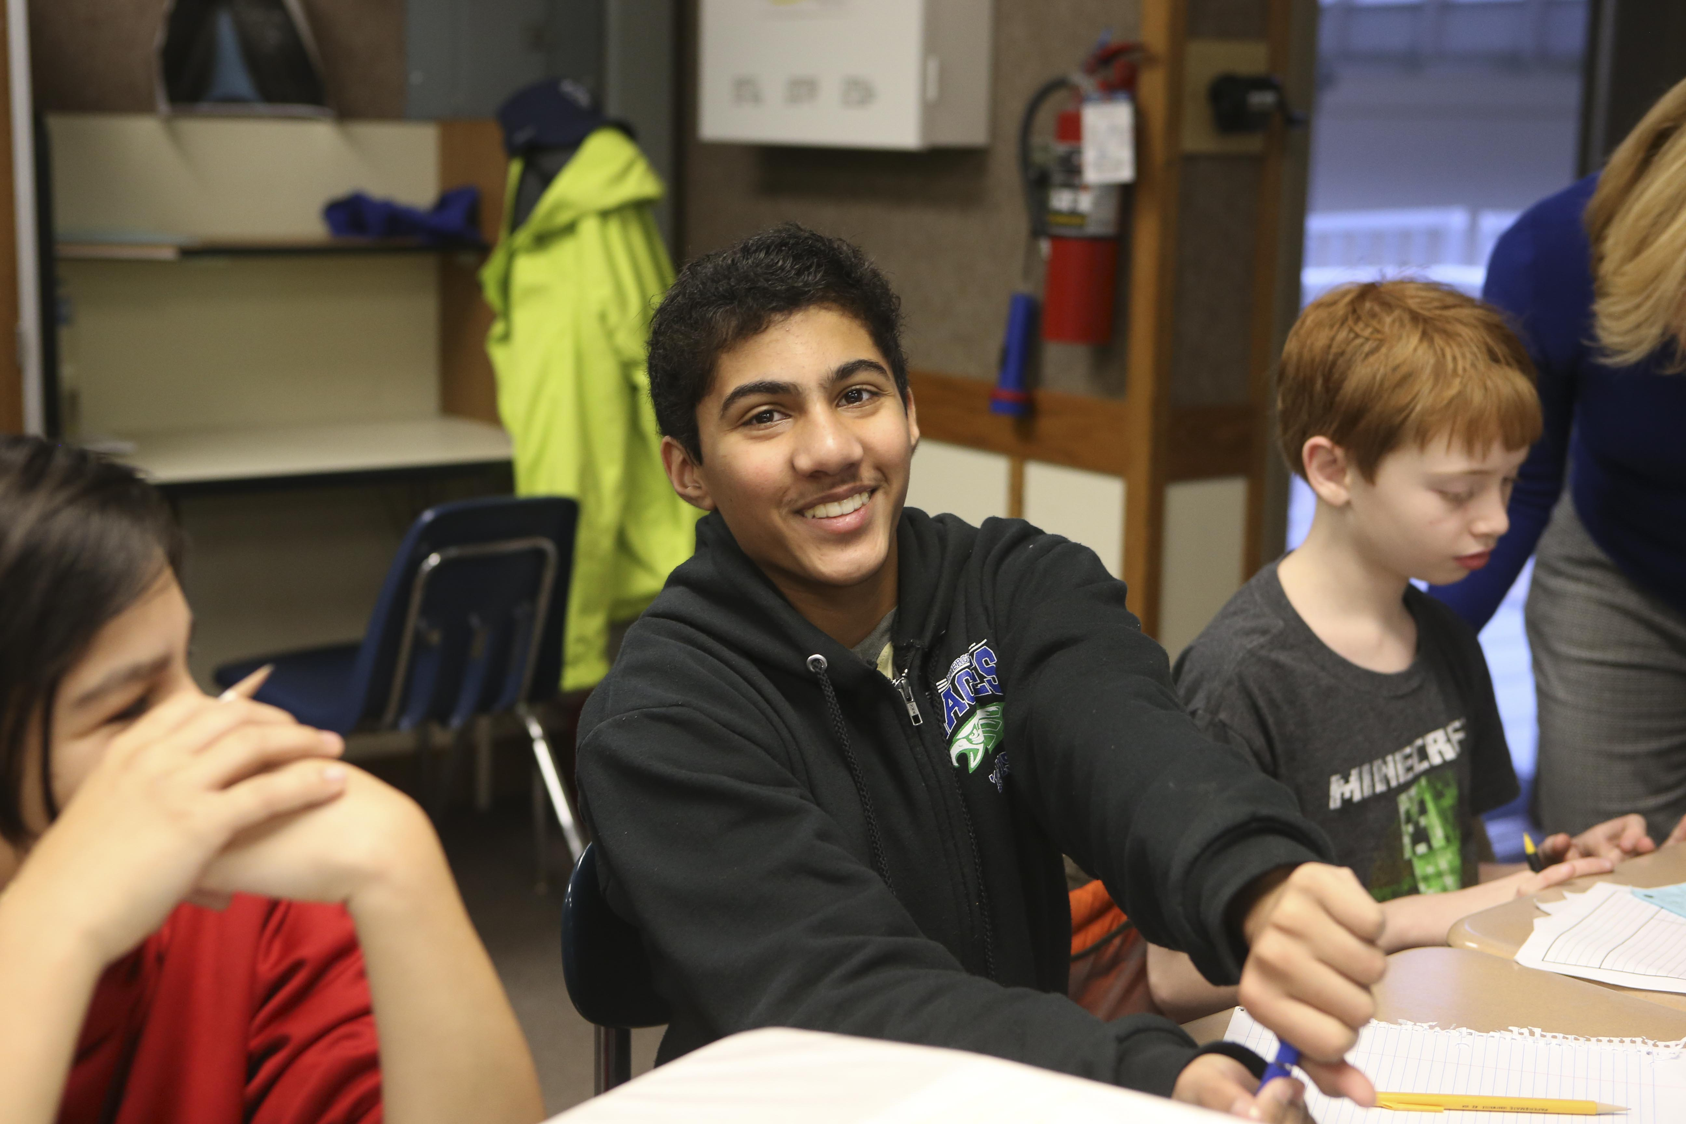
Thank you for supporting LWSD students!
Visit us at www.lwsf.org
DISTRICT-WIDE investments that impact all students
• IXL Online Math
New Teacher Support
AVID College Readiness Program
LINKS Mentoring Program
Classroom Grants and more

Slide 18
GET INVOLVED!
How can you help? VOLUNTEER!
Volunteer applications available in office – will background check
Classroom volunteer opportunities begin in a few weeks
SUBSCRIBE to the Bugle
Email “subscribe” to rockwellbugle@gmail.com
Sign up to join our PTA!

